Slide 1
Computer Networks
Analog and Digital Signals

Slide 2
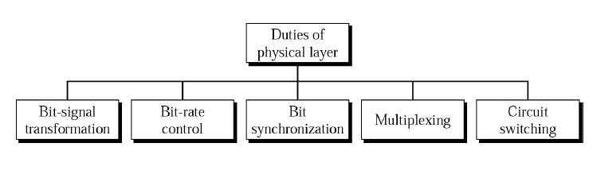

Physical Layer
Responsibilities:
Move data in the form of electromagnetic signals across a transmission medium

Slide 3
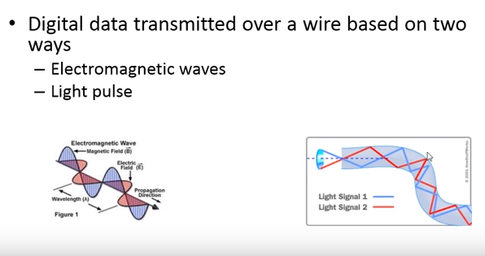

Analog and Digital Signalling

Slide 4
Analog and Digital Data
Data can be analog or digital.
Analog data ➔refers to information that is continuous;
Analog data take on continuous values
Digital data ➔ refers to information that has discrete states.
Digital data take on discrete values

Slide 5
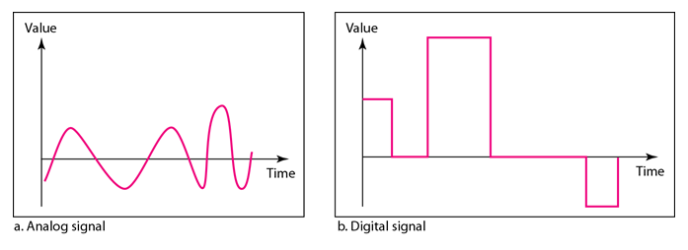
Analog and Digital Signals
Signals can be analog or digital.
Analog signals can have an infinite number of values in a range.
Digital signals can have only a limited number of values

Slide 6

Periodic and Nonperiodic
Both analog and digital signals can take one of two forms:
periodic or nonperiodic
A periodic signal →completes a pattern within a measurable time frame, called a period, and repeats that pattern over subsequent identical periods.
The completion of one full pattern is called a cycle.
A nonperiodic signal changes without exhibiting a pattern or cycle that repeats over time.

Slide 7
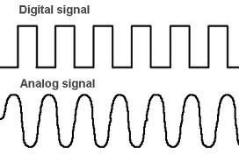
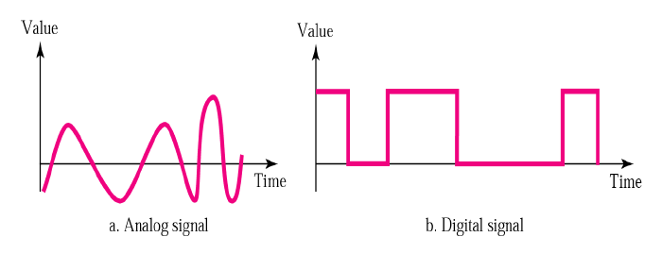
Periodic and Aperiodic
.

Slide 8
Analog Signals
.

Slide 9
PERIODIC ANALOG SIGNALS
Periodic analog signals can be classified as
Simple➔ sine wave, cannot be decomposed into simpler signals
Composite➔ multiple sine wave

Slide 10
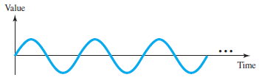
Sine Wave
A sine wave can be represented by three parameters:
the peak amplitude
the frequency
the phase

Slide 11
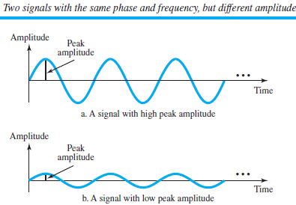
Peak Amplitude
The peak amplitude of a signal is the absolute value of its highest intensity, proportional to the energy it carries.
For electric signals, peak amplitude is normally measured in volts

Slide 12


Period and Frequency
Period refers to the amount of time, in seconds, a signal needs to complete 1 cycle.
expressed in seconds
Frequency refers to the number of periods in 1 s.
expressed in Hertz (Hz), which is cycle per second

Slide 13
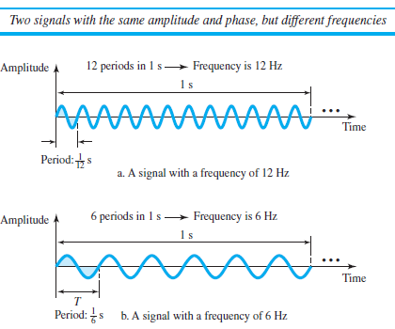
Example

Slide 14
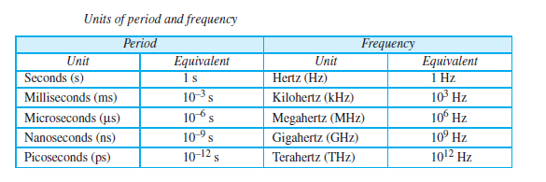
Units

Slide 15

Examples
The power we use at home has a frequency of 60 Hz The period of this sine wave can be determined as follows:

Slide 16
Examples
Express a period of 100 ms in microseconds.
Solution
find the equivalents of 1 ms (1 ms is 10⁻³ s) and
1 s (1 s is 10⁶ μs).

Slide 17

Examples
The period of a signal is 100 ms. What is its frequency in kilohertz?
Solution
First we change 100 ms to seconds, and then calculate the frequency from the period (1 Hz = 10⁻³ kHz).

Slide 18
Frequency is the rate of change with respect to time. Change in a short span of time
means high frequency. Change over a long span of time means low frequency.
If a signal does not change at all, its frequency is zero.
If a signal changes instantaneously, its frequency is infinite.

Slide 19
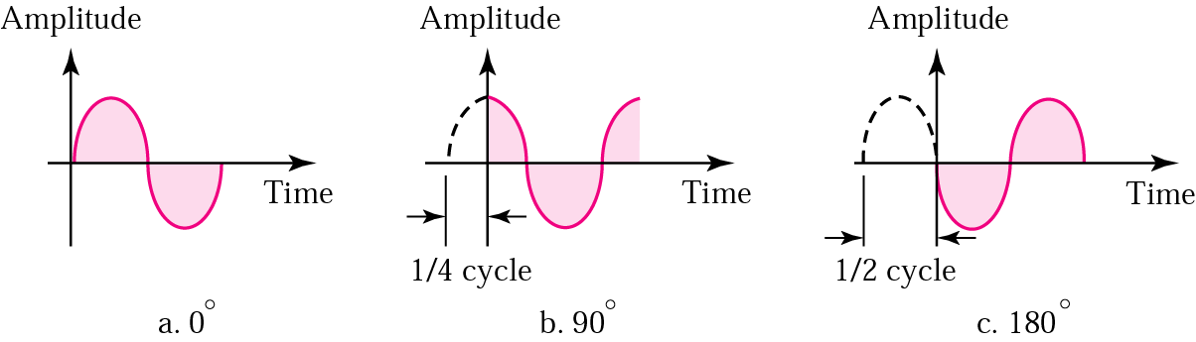
Phase
The term phase, or phase shift, describes the position of the waveform relative to time 0.
Phase is measured in degrees or radians.

Slide 20
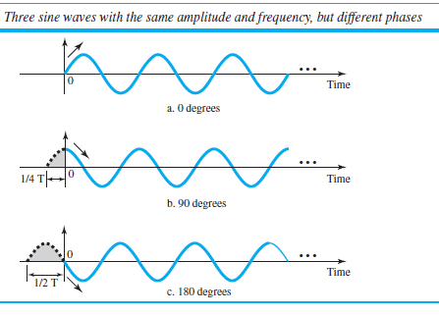
A sine wave with a phase of 0° starts at time 0 with a zero amplitude. The amplitude is increasing.
A sine wave with a phase of 90° starts at time 0 with a peak amplitude. The amplitude is decreasing.
A sine wave with a phase of 180° starts at time 0 with a zero amplitude. The amplitude is decreasing.
phase is in terms of shift or offset:
a. A sine wave with a phase of 0° is not shifted.
b. A sine wave with a phase of 90° is shifted to the left by ¼ cycle. However, note that the signal does not really exist before time 0.
c. A sine wave with a phase of 180° is shifted to the left by ½ cycle. However, note that the signal does not really exist before time 0.

Slide 21

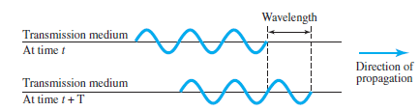
Wavelength
Wavelength is another characteristic of a signal traveling through a transmission medium.
Wavelength binds the period or the frequency of a simple sine wave to the propagation speed of the medium→ measured in micrometers (microns)

Slide 22
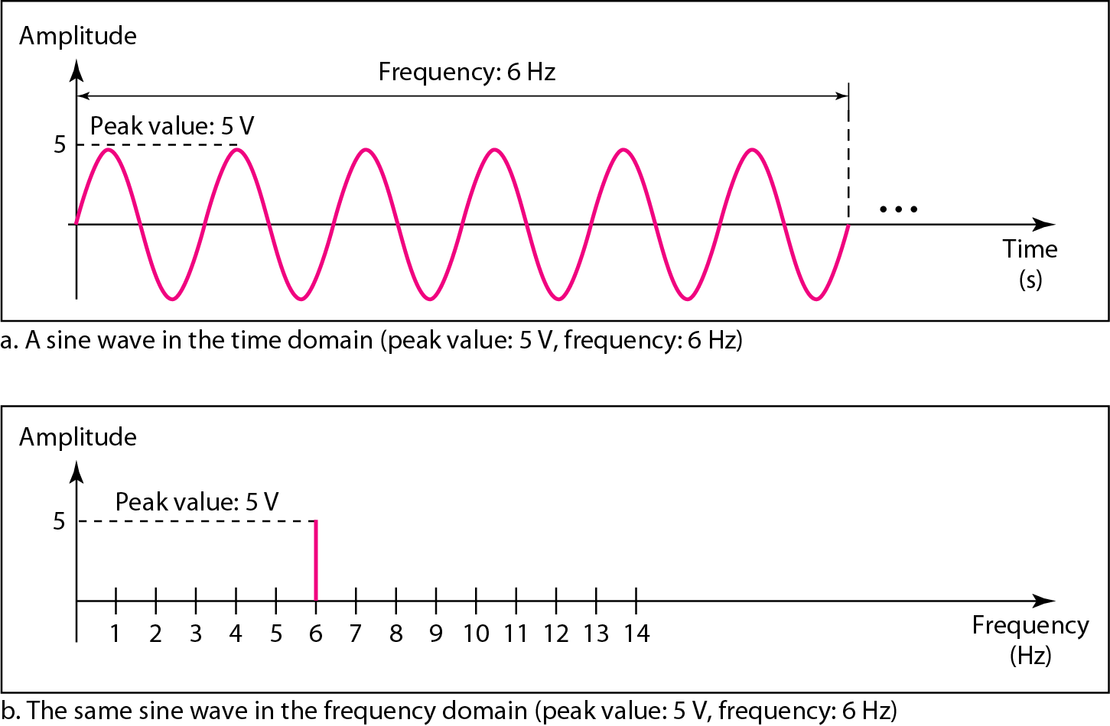
Time and Frequency Domains
The time-domain and frequency-domain plots of a sine wave
A complete sine wave in the time domain can be represented by one single spike in the frequency domain.

Slide 23
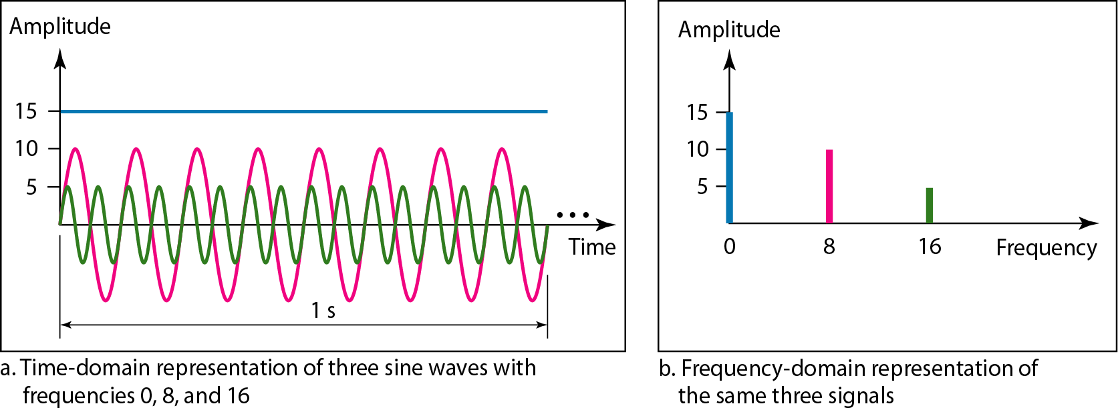
Frequency domain is more compact and useful when we are dealing with more than one sine wave

Slide 24

Applications of Single sine wave
We can send a single sine wave to carry electric energy from one place to another.
The power company sends a single sine wave with a frequency of 60 Hz to distribute electric energy to houses and businesses.
the sine wave is carrying energy
To send an alarm to a security centre when a burglar opens a door or window in the house.
the sine wave is carrying a signal of danger

Slide 25

Composite Signals
Composite signal is actually a combination of simple sine waves with different frequencies, amplitudes, and phases.

Slide 26
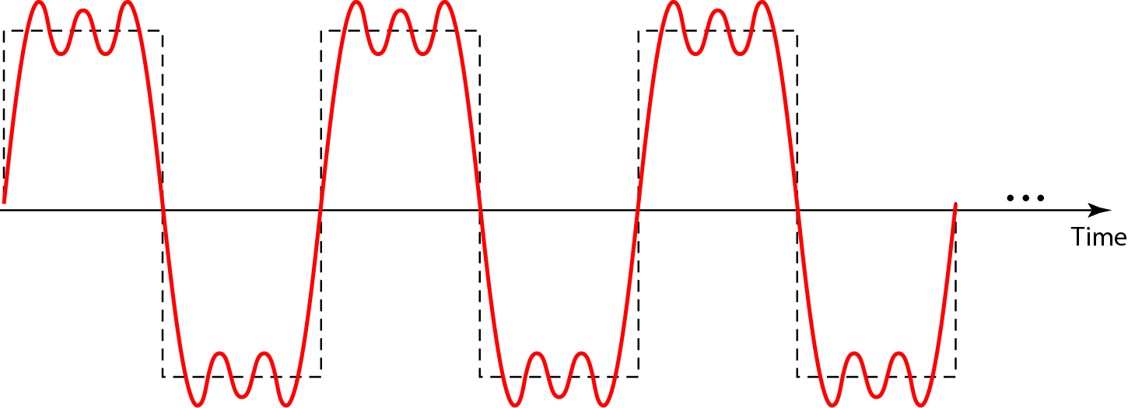
A composite periodic signal

Slide 27
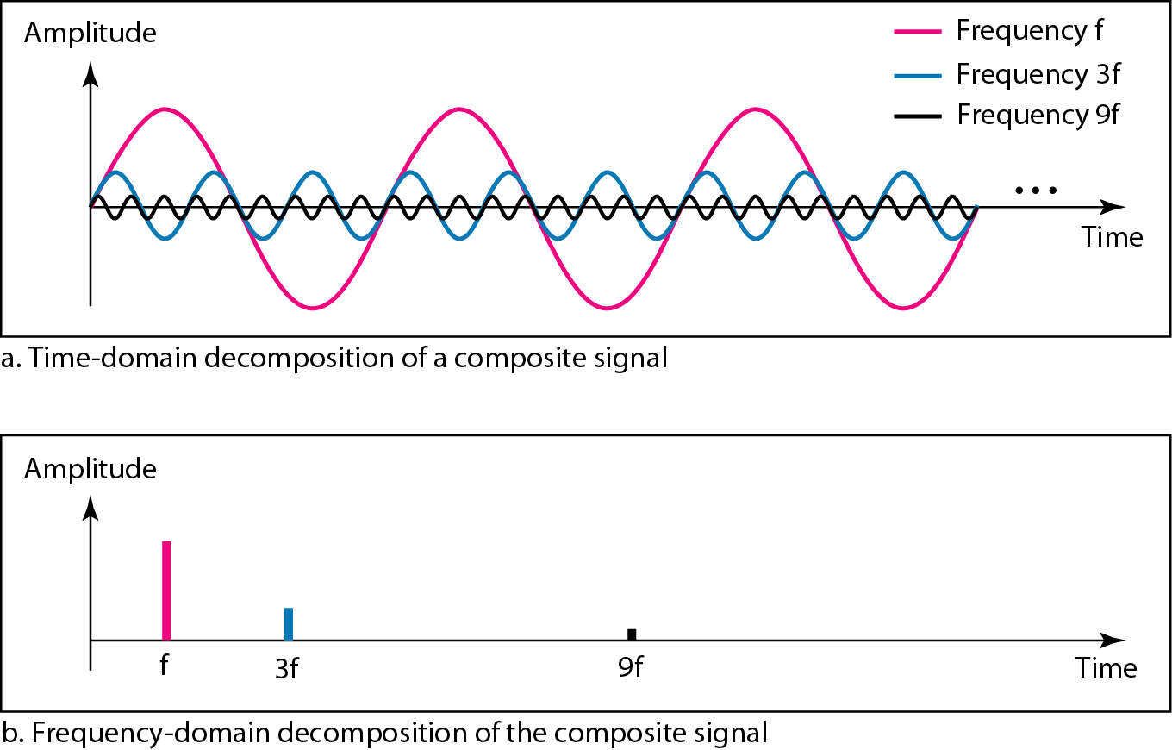
Decomposition of a composite periodic signal in the time and frequency domains
The frequency of the sine wave with frequency f is the same as the frequency of the composite signal;
It is called the fundamental frequency, or first harmonic.
Is the lowest frequency
Sine wave with frequency 3f :
Has a frequency of 3 times the fundamental frequency➔ third harmonic
Sine wave with frequency 9f :
Has a frequency of 9 times the fundamental frequency➔ ninth harmonic

Slide 28
Bandwidth
The range of frequencies contained in a composite signal is its bandwidth
The bandwidth of a composite signal is the difference between the highest and the lowest frequencies contained in that signal

Slide 29
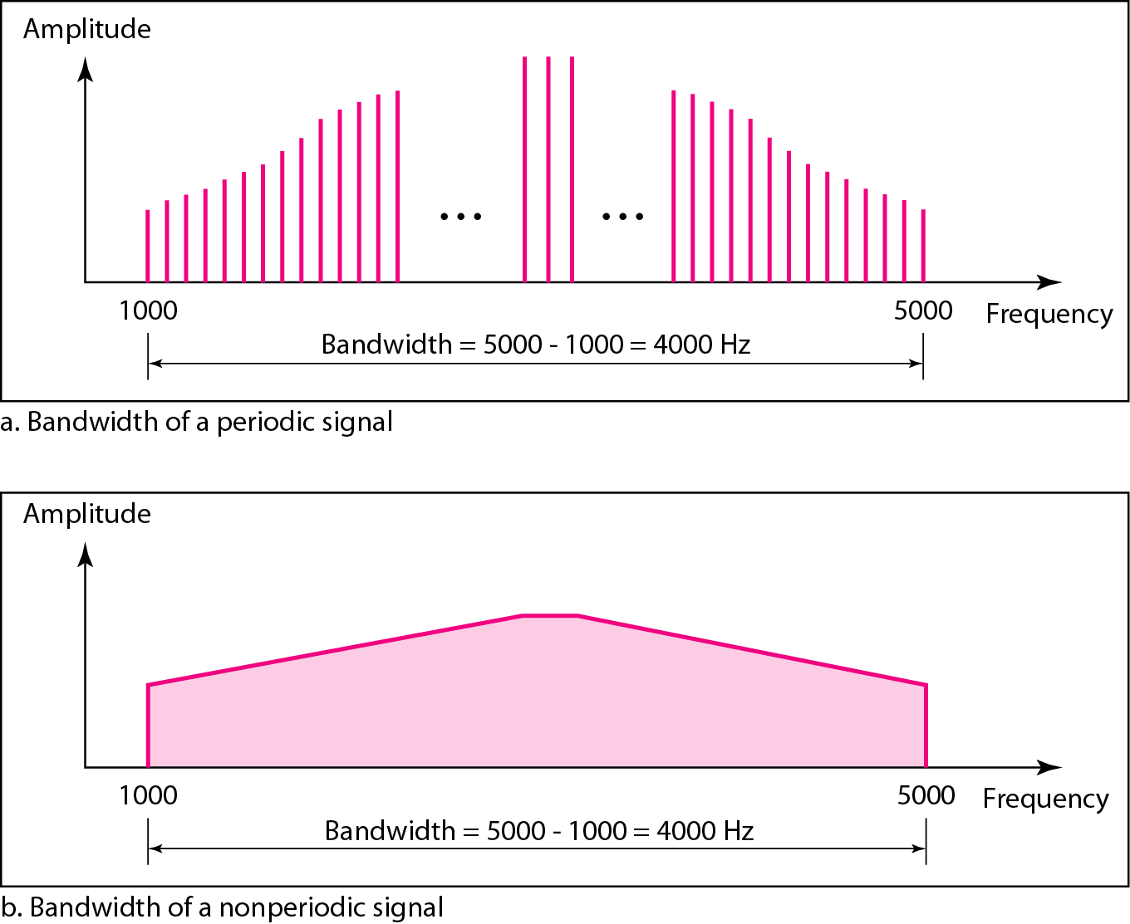
The bandwidth of periodic and nonperiodic composite signals

Slide 30
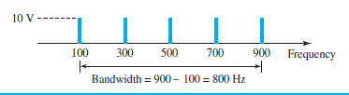
Examples
If a periodic signal is decomposed into five sine waves with frequencies of 100, 300, 500, 700, and 900 Hz, what is its bandwidth? Draw the spectrum, assuming all components have a maximum amplitude of 10 V.
Solution
Let f_{h} be the highest frequency, f_{l} the lowest frequency, and B the bandwidth. Then
The spectrum has only five spikes, at 100, 300, 500, 700, and 900 Hz

Slide 31
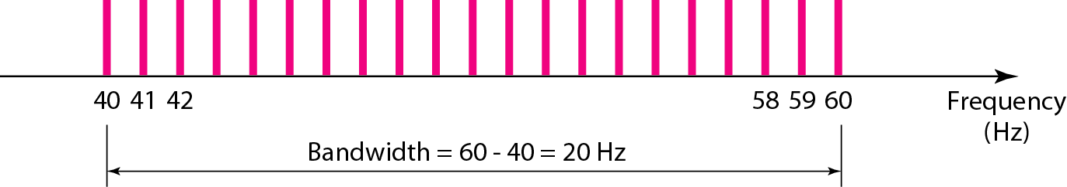
Examples
A periodic signal has a bandwidth of 20 Hz. The highest frequency is 60 Hz. What is the lowest frequency? Draw the spectrum if the signal contains all frequencies of the same amplitude.
Solution
Let f_{h} be the highest frequency, f_{l} the lowest frequency, and B the bandwidth. Then
The spectrum contains all integer frequencies. We show this by a series of spikes.

Slide 32
BW=200Hz
MF=140 Hz
MF=LF+dist
LF=MF-Dist=40
HF=MF+Dist=240
BW/2=100

Slide 33
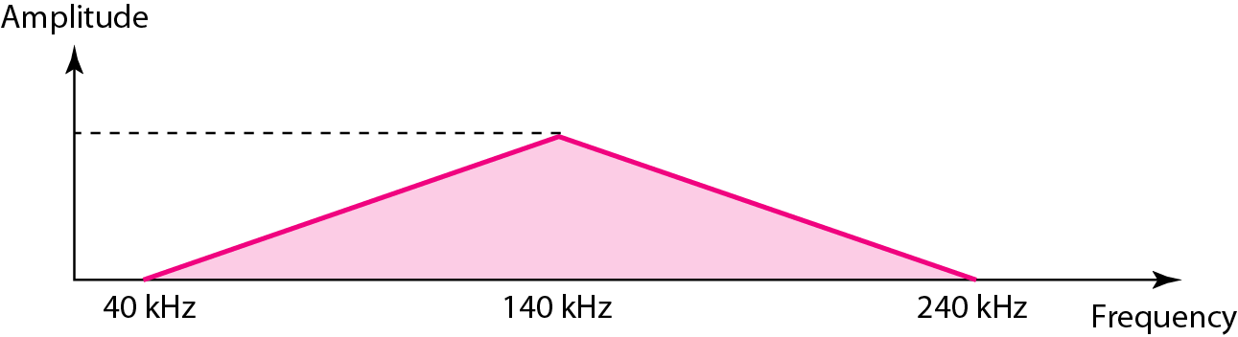
Examples
A nonperiodic composite signal has a bandwidth of 200 kHz, with a middle frequency of 140 kHz and peak amplitude of 20 V. The two extreme frequencies have an amplitude of 0. Draw the frequency domain of the signal.
Solution
The lowest frequency must be at 40 kHz and the highest at 240 kHz.
Lowest=Middle F- B/2
Highest=Middle F +B/2

Slide 34
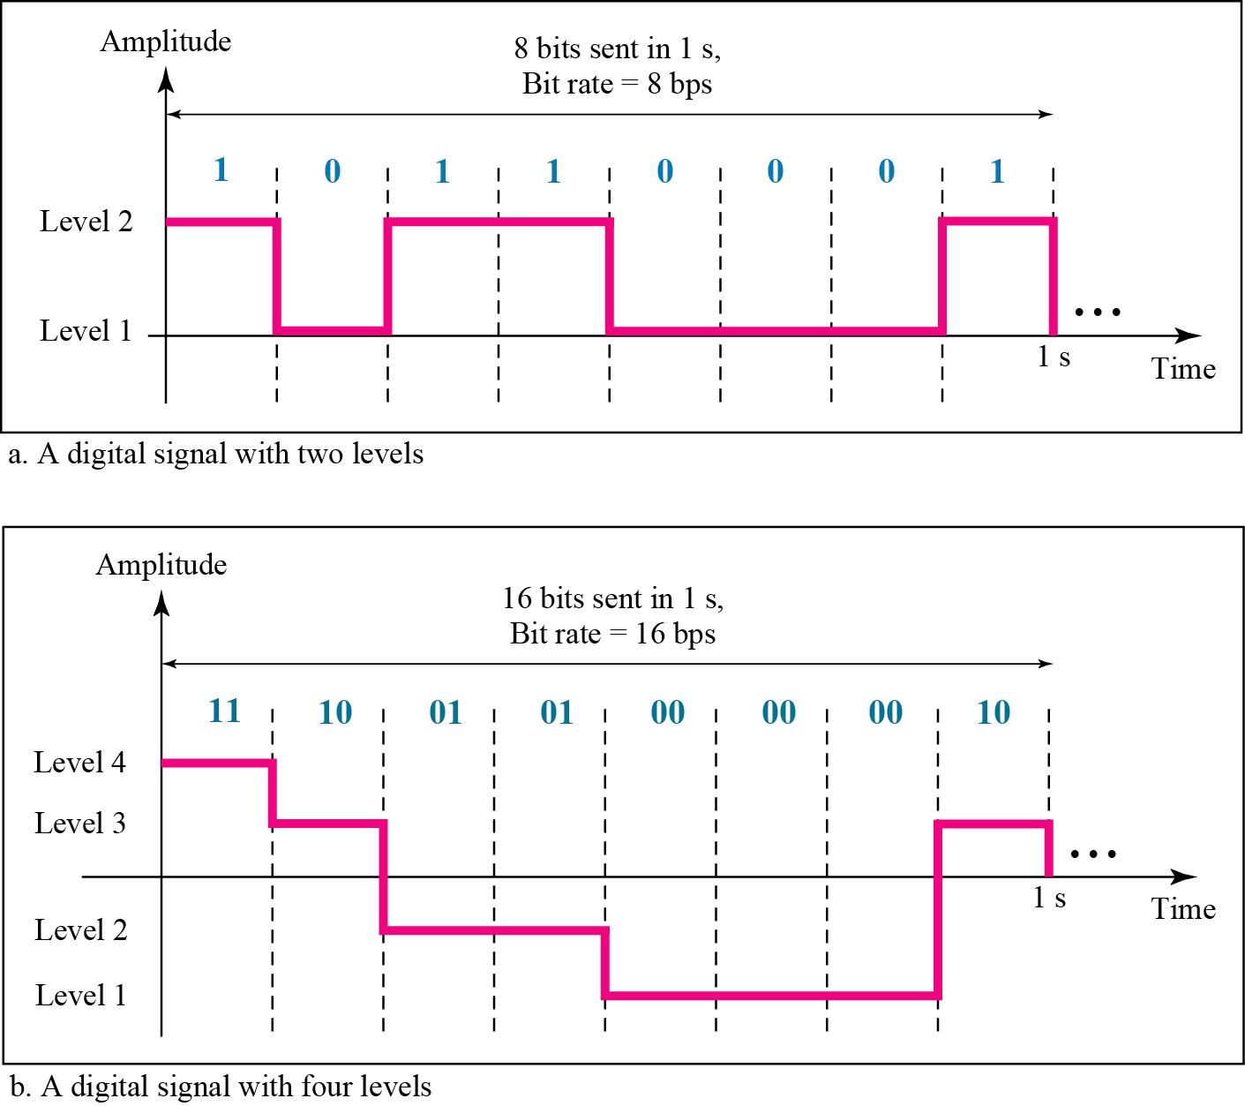
Digital Signals
1 can be encoded as a positive voltage and a 0 as zero voltage
Digital signals have 0s and 1s
A digital signal can have more than two levels
We can send more than 1 bit for each level.
Number of bits per level L =

Slide 35
Bit Rate
Most digital signals are nonperiodic, and thus period and frequency are not appropriate characteristics.
bit rate (instead of frequency)—is used to describe digital signals.
The bit rate is the number of bits sent in 1s, expressed in bits per second (bps)

Slide 36
Example
A digital signal has eight levels. How many bits are needed per level? We calculate the number of bits from the formula
Each signal level is represented by 3 bits.

Slide 37
Example
A digital signal has nine levels. How many bits are needed per level?
Each signal level is represented by 3.17 bits.
The number of bits sent per level needs to be an integer as well as a power of 2. For this example, 4 bits can represent one level.

Slide 38
Example
Assume we need to download text documents at the rate of 100 pages per sec. What is the required bit rate of the channel?
Solution
A page is an average of 24 lines with 80 characters in each line. If we assume that one character requires 8 bits (ascii), the bit rate is

Slide 39
Example
A digitized voice channel, is made by digitizing a 4-kHz bandwidth analog voice signal. We need to sample the signal at twice the highest frequency (two samples per hertz). We assume that each sample requires 8 bits. What is the required bit rate?
Solution
The bit rate can be calculated as

Slide 40
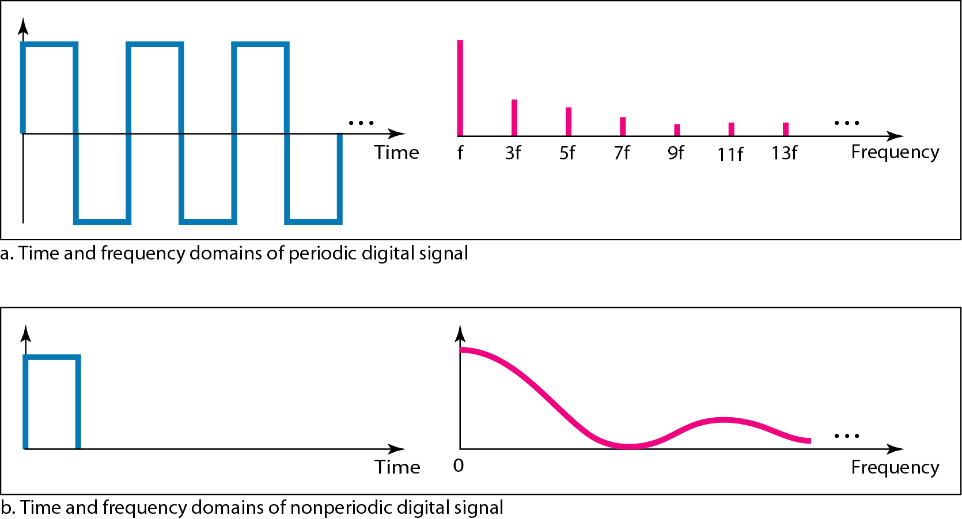
The time and frequency domains of periodic and nonperiodic digital signals

Slide 41
Bit Length
Like wavelength for an analog signal: the distance one cycle occupies on the transmission medium.
Bit length for a digital signal: the bit length.
The bit length is the distance one bit occupies on the transmission medium.

Slide 42
Transmission of Digital Signals
We can transmit a digital signal by using one of two different approaches:
baseband transmission or broadband transmission

Slide 43
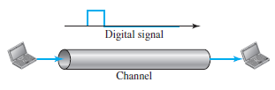
Baseband Transmission
Baseband transmission means sending a digital signal over a channel without changing the digital signal to an analog signal

Slide 44
Requirements for Baseband Transmission
a low-pass channel, a channel with a bandwidth that starts from zero:
dedicated medium with a bandwidth constituting only one channel.
For example,
the entire bandwidth of a cable connecting two computers is one single channel.
We may connect several computers to a bus, but not allow more than two stations to communicate at a time.

Slide 45
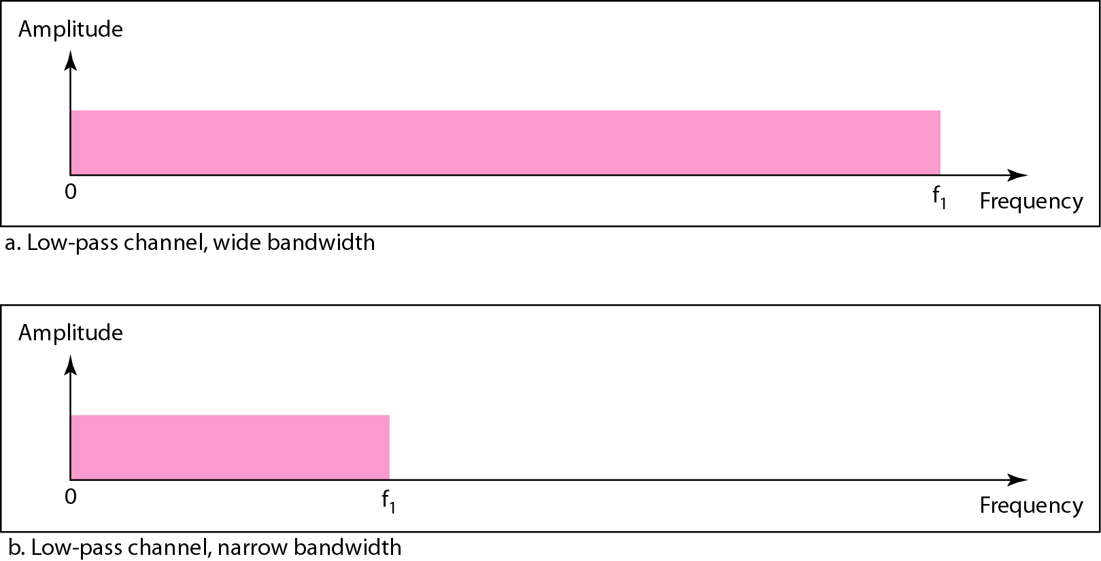
A low-pass channel with a wide bandwidth and a narrow bandwidth

Slide 46
Example of a dedicated channel where the entire bandwidth of the medium is used as one single channel
LAN
Almost every wired LAN today uses a dedicated channel for two stations communicating with each other.
In a bus topology LAN with multipoint connections, only two stations can communicate with each other at each moment in time (timesharing);
the other stations need to refrain from sending data.
In a star topology LAN, the entire channel between each station and the hub is used for communication between these two entities

Slide 47
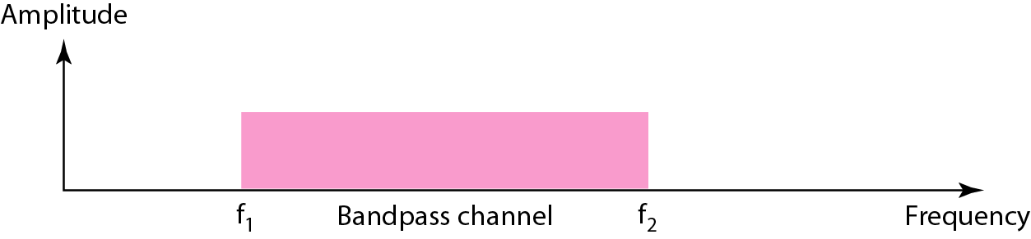
Broadband Transmission (Using Modulation)
Broadband transmission or modulation means changing the digital signal to an analog signal for transmission
Modulation allows us to use a bandpass channel—a channel with a bandwidth that does not start from zero.
This type of channel is more available than a low-pass channel
Bandwidth of a bandpass channel

Slide 48
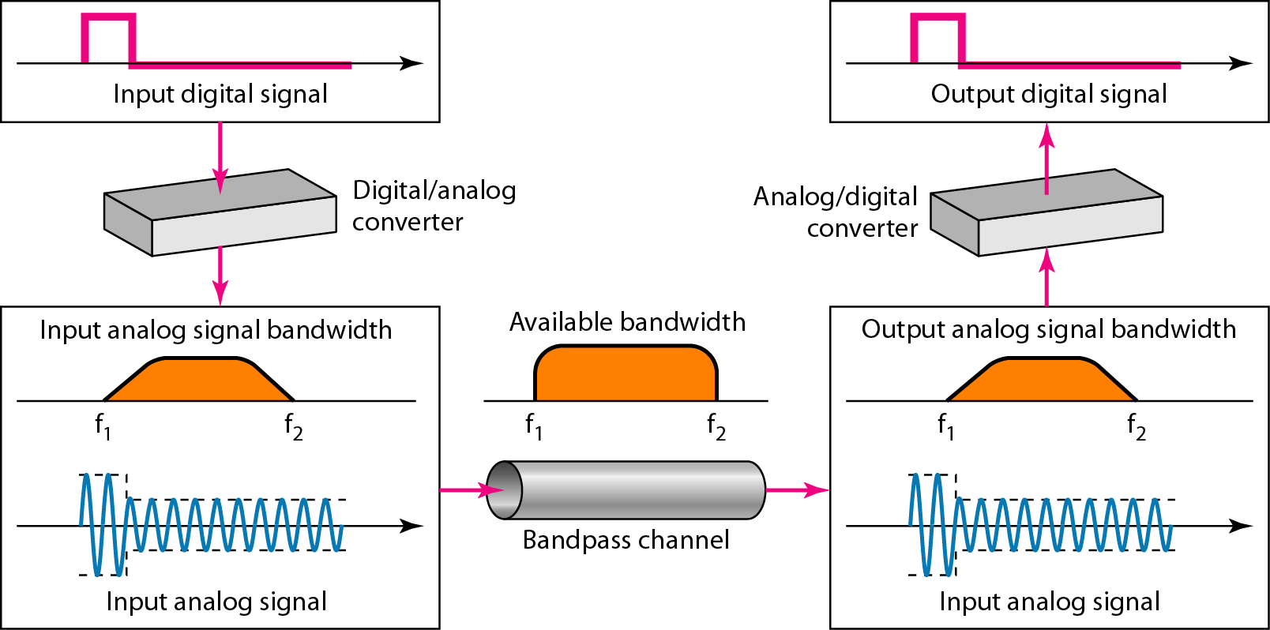
Modulation of a digital signal for transmission on a bandpass channel
composite analog signal.

Slide 49
TRANSMISSION IMPAIRMENT
Signals travel through transmission media, which are not perfect.
The imperfection causes signal impairment.
This means that the signal at the beginning of the medium is not the same as the signal at the end of the medium

Slide 50
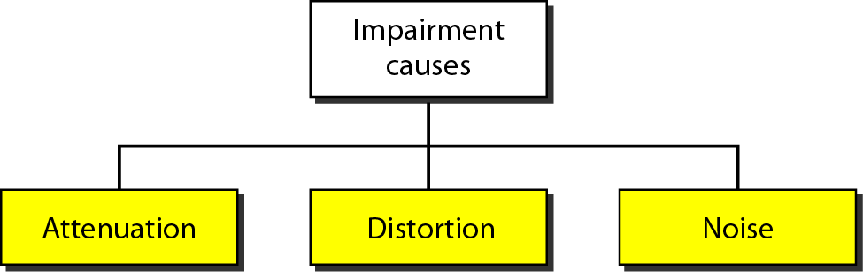
Causes of impairment
Signal losses some of its energy
Signal changes its shape
corrupts the signal

Slide 51
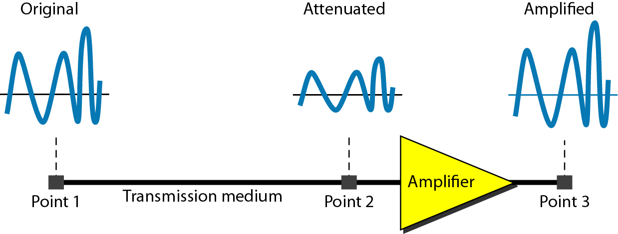
Attenuation
When a signal, simple or composite, travels through a medium, it loses some of its energy in overcoming the resistance of the medium.
To compensate for this loss, amplifiers are used to amplify the signal

Slide 52
Distortion
Distortion means that the signal changes its form or shape
Distortion can occur in a composite signal made of different frequencies
Each signal component has its own propagation speed through a medium
Has its own delay in arriving at the final destination.
Differences in delay may create a difference in phase if the delay is not exactly the same as the period duration.
Signal components at the receiver have phases different from what they had at the sender.

Slide 53
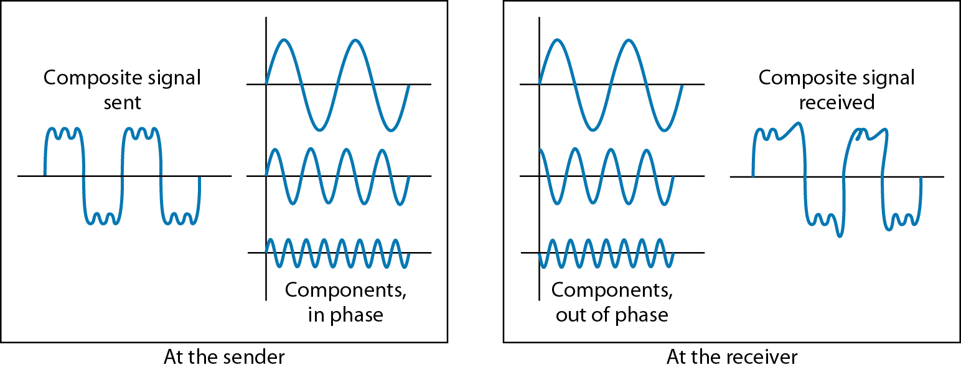
Distortion

Slide 54
Noise
Several types of noise may corrupt the signal
Thermal noise is the random motion of electrons in a wire, which creates an extra signal not originally sent by the transmitter.
Induced noise comes from sources such as motors and appliances
These devices act as a sending antenna, and the transmission medium acts as the receiving antenna.
Crosstalk is the effect of one wire on the other.
One wire acts as a sending antenna and the other as the receiving antenna.
Impulse noise is a spike (a signal with high energy in a very short time) that comes from power lines, lightning, and so on.

Slide 55
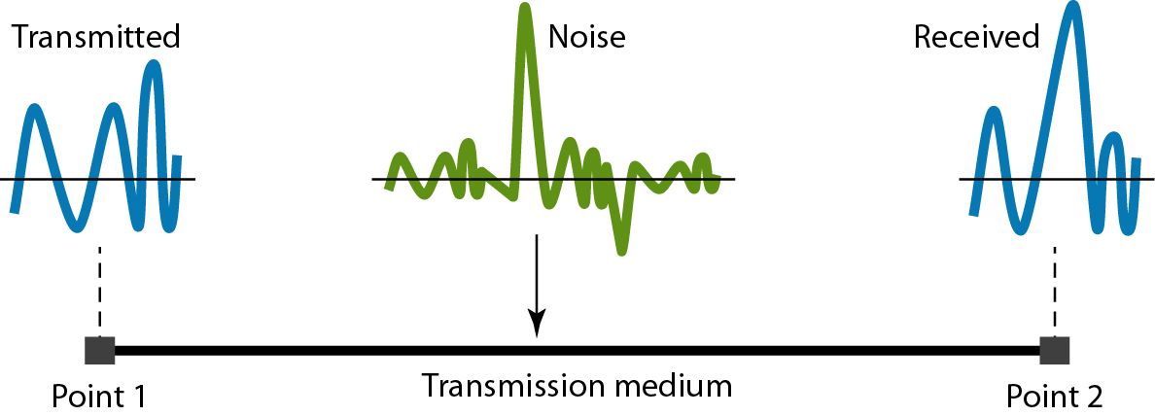
Noise

Slide 56


Signal-to-Noise Ratio
Signal-to-Noise Ratio
SNR is actually the ratio of what is wanted (signal) to what is not wanted (noise).
High SNR➔ Less corrupted
Low SNR➔ Highly Corrupted

Slide 57
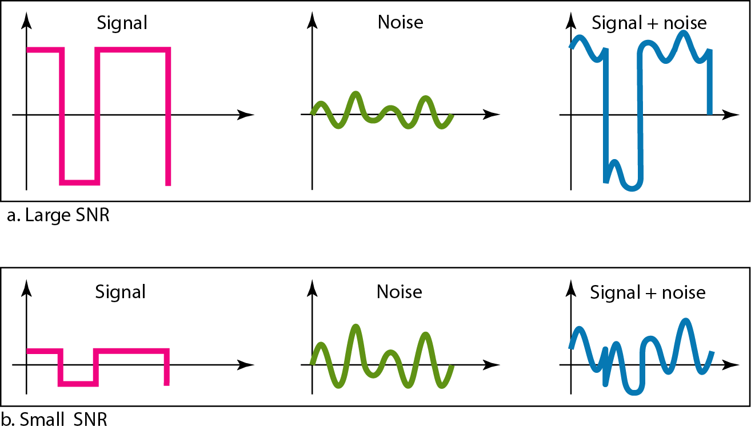
Two cases of SNR: a high SNR and a low SNR

Slide 58
DATA RATE LIMITS
A very important consideration in data communications is how fast we can send data, in bits per second, over a channel.
Data rate depends on three factors:
1. The bandwidth available
2. The level of the signals we use
3. The quality of the channel (the level of noise)

Slide 59


Formulas to calculate the data rate
Noiseless Channel: Nyquist Bit Rate
L➔No of signal Levels
bandwidth ➔the bandwidth of the channel
Noisy channel: Shannon Capacity
bandwidth ➔ bandwidth of the channel
SNR ➔ signal-to noise ratio,
Capacity➔ capacity of the channel in bits per second.

Slide 60
Example Nyquist
Consider a noiseless channel with a bandwidth of 3000 Hz transmitting a signal with two signal levels. The maximum bit rate can be calculated as
Consider the same noiseless channel transmitting a signal with four signal levels (for each level, we send 2 bits). The maximum bit rate can be calculated as

Slide 61
Example-Shannon Capacity
Consider an extremely noisy channel in which the value of the signal-to-noise ratio is almost zero. In other words, the noise is so strong that the signal is faint. For this channel the capacity C is calculated as
This means that the capacity of this channel is zero regardless of the bandwidth. In other words, we cannot receive any data through this channel.

Slide 62
Example-Shannon Capacity
We can calculate the theoretical highest bit rate of a regular telephone line. A telephone line normally has a bandwidth of 3000. The signal-to-noise ratio is usually 3162. For this channel the capacity is calculated as
This means that the highest bit rate for a telephone line is 34.860 kbps. If we want to send data faster than this, we can either increase the bandwidth of the line or improve the signal-to-noise ratio.

Slide 63
PERFORMANCE OF THE NETWORK
Bandwidth
Throughput
Latency (Delay)
Jitter

Slide 64
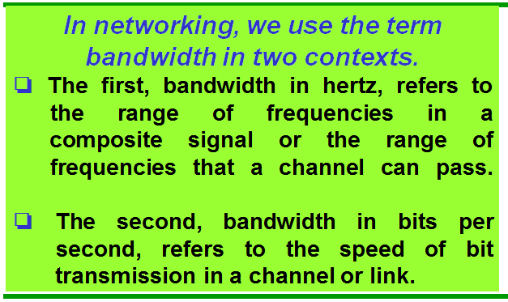
Bandwidth
the bandwidth of a subscriber telephone line is 4 kHz.
the bandwidth of a Fast Ethernet network (or the links in this network) is a maximum of 100 Mbps.
This means that this network can send 100 Mbps

Slide 65
Throughput
The throughput is a measure of how fast we can actually send data through a network
Eg: we may have a link with a bandwidth of 1 Mbps, but the devices connected to the end of the link may handle only 200 kbps.
The bandwidth (B) is a potential measurement of a link; the throughput (T) is an actual measurement of how fast we can send data. Always T<B

Slide 66
Latency (Delay)
The latency or delay defines how long it takes for an entire message to completely arrive at the destination from the time the first bit is sent out from the source
Propagation Time➔ measures the time required for a bit to travel from the source to the destination.

Slide 67
Latency (Delay)
Transmission Time➔ depends on the size of the message and the bandwidth of the channel.
Queuing Time➔ the time needed for each intermediate or end device to hold the message before it can be processed

Slide 68
Jitter
if different packets of data encounter different delays and the application using the data at the receiver site is time-sensitive
Example: Audio and Video data
If the delay for the first packet is 20 ms, for the second is 45 ms, and for the third is 40 ms, then the real-time application that uses the packets endures jitter.

Slide 69

Example 3.44
A network with bandwidth of 10 Mbps can pass only an average of 12,000 frames per minute with each frame carrying an average of 10,000 bits. What is the throughput of this network?
Solution
We can calculate the throughput as
The throughput is almost one-fifth of the bandwidth in this case.

Slide 70
Example 3.45
What is the propagation time if the distance between the two points is 12,000 km? Assume the propagation speed to be 2.4 × 108 m/s in cable.
Solution
We can calculate the propagation time as
The example shows that a bit can go over the Atlantic Ocean in only 50 ms if there is a direct cable between the source and the destination.

Slide 71
Example 3.46
What are the propagation time and the transmission time for a 2.5-kbyte message (an e-mail) if the bandwidth of the network is 1 Gbps? Assume that the distance between the sender and the receiver is 12,000 km and that light travels at 2.4 × 108 m/s.
Solution
We can calculate the propagation and transmission time as shown on the next slide:

Slide 72
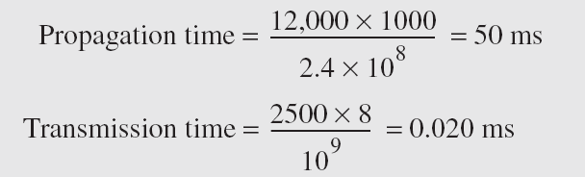
Example 3.46 (continued)
Note that in this case, because the message is short and the bandwidth is high, the dominant factor is the propagation time, not the transmission time. The transmission time can be ignored.

Slide 73
Example 3.47
What are the propagation time and the transmission time for a 5-Mbyte message (an image) if the bandwidth of the network is 1 Mbps? Assume that the distance between the sender and the receiver is 12,000 km and that light travels at 2.4 × 10⁸ m/s.
Solution
We can calculate the propagation and transmission times as shown on the next slide.

Slide 74
Example 3.47 (continued)
Note that in this case, because the message is very long and the bandwidth is not very high, the dominant factor is the transmission time, not the propagation time. The propagation time can be ignored.

Slide 75
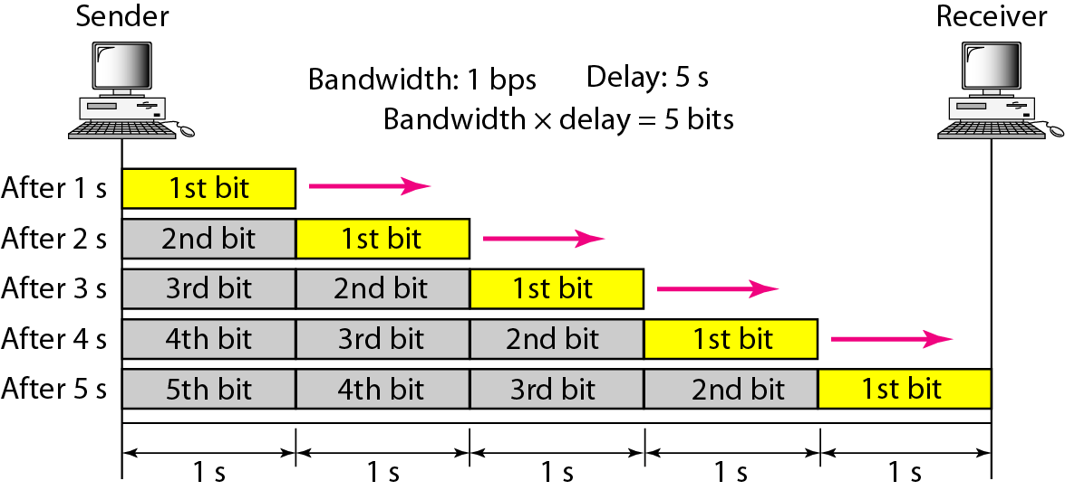
Figure 3.31 Filling the link with bits for case 1

Slide 76
Example 3.48
We can think about the link between two points as a pipe. The cross section of the pipe represents the bandwidth, and the length of the pipe represents the delay. We can say the volume of the pipe defines the bandwidth-delay product, as shown in Figure 3.33.

Slide 77
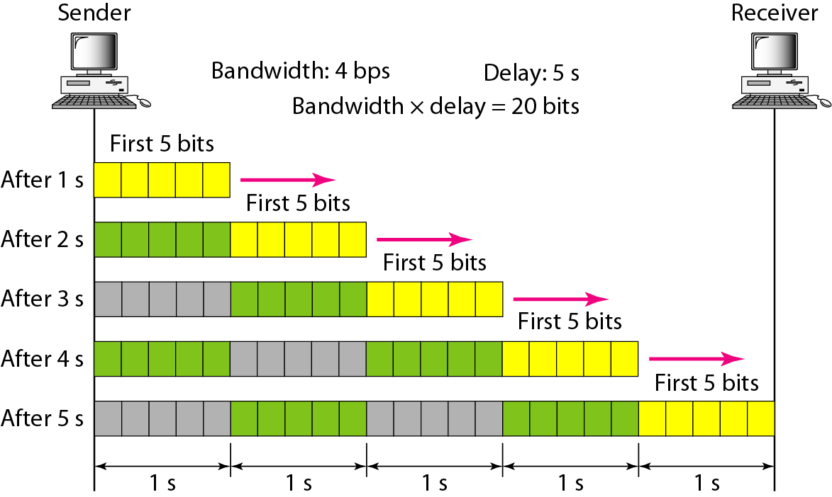
Figure 3.32 Filling the link with bits in case 2

Slide 78

Note
The bandwidth-delay product defines the number of bits that can fill the link.

Slide 79

Figure 3.33 Concept of bandwidth-delay product

